Slide 1

Replicating Statistical Analysis Group 4: Raphael Kirchgäßner, Brian Karlberg, Meenakshi Mishra
Verbal monitoring in Parkinson’s disease: A comparison between internal and external monitoring Hanna S. Gauvin, Jolien Mertens, Peter Marien, Patrick Santens, Barbara A. Pickut, Robert J. Hartsuiker

Slide 2
Summary of the paper we replicated
Simple research questions
Is verbal monitoring impaired in patients with Parkinson’s disease (PD)
Can internal tasks on speech perception predict internal monitoring performance?
Definition of key constructs
Internal vs. external monitoring
Pre/post articulation monitoring routes
Internal mechanism theories: perception or production based
Insights from other neurological disorders (Alzheimer’s, stroke, etc.)
Semantic vs. phonological impairments, syntactic complexity, etc.
Notes:
Grammatical errors
Prosody – intonation
Phoneme – distinct sounds
Meta result: PD patients do not differ in verbal monitoring performance rather they differ in how they achieve verbal monitoring.
Control variable results
Pos corr Hoehn and Yahr and MMSE, r=.54 , p=.044
Significant correlation between age and Hohn Yahr, age and MMSE p=.009, and Length of Parkenson’s p=.02, and deep brain STN stimulation p=.008
Negative correlation between age and MMSE -.343, p=.047
Speech production
No significant difference between PD and control group based on most individual correlations
Internal speech perception
Rhyme judgment task
Homophone decision task
Phoneme monitoring task
External speech perception
Rhyme judgement task
Network perception task
Verbal monitoring variables
Disfluencies
Relationship

Slide 3
Brief overview of measurement methods
Key method: noise masking to block external monitoring
Route to investigate functionality of internal monitoring
Regression to predict monitoring performance based on measures of production and perception
Unified Parkinson’s Disease Rating Scale n=18, control group n=16
11 language tasks grouped into 4 categories:
Speech production
Internal speech perception
External speech perception
Verbal monitoring
Notes:
Fill out regression conclusions

Slide 4




Methods (continued)
Boston Naming Test (BNT)
Controlled oral word association test (COWAT)
Cognitive performance tests
Mini mental state examination (MMSE)
Raven Matrices
Software and hardware:
E-Prime and PowerPoint running on laptop
Cedrus RB-x30 response box
Sennheiser HD 250 over-ear headphones
Roland R-1 mp3 recorder

Slide 5
Issues identified in data quality review
Raw table data apparently labeling fractions as percentages
Understanding what the data variables represented – examples:
Lepodova
Hoehn Yahr Scale
MMSE
Gender variable coded as one or zero, m and v elsewhere
Potential for geographic bias
Small sample size < 30

Slide 6
EDA highlights, focusing on why each plot/data summary table was done, and what was learned

Slide 7
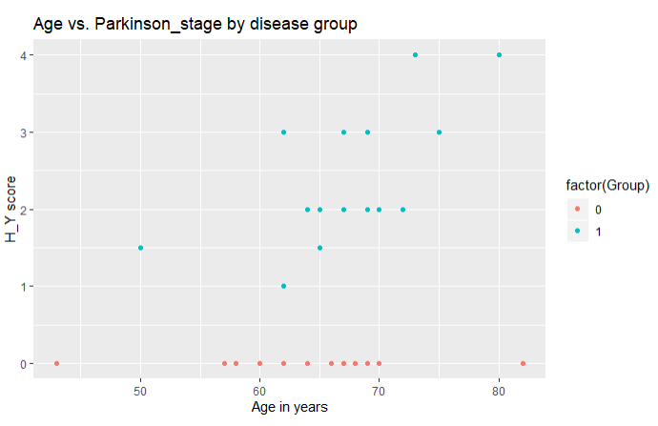
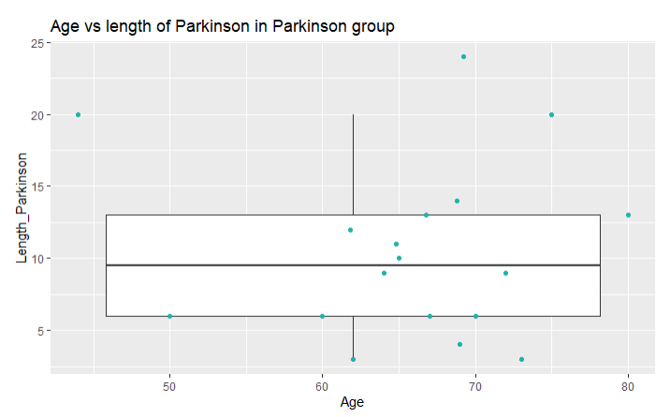
EDA highlights, focusing on why each plot/data summary table was done, and what was learned
Small sample size and wide variation in age, disease state & Length of disease

Slide 8
EDA highlights, focusing on why each plot/data summary table was done, and what was learned

Slide 9
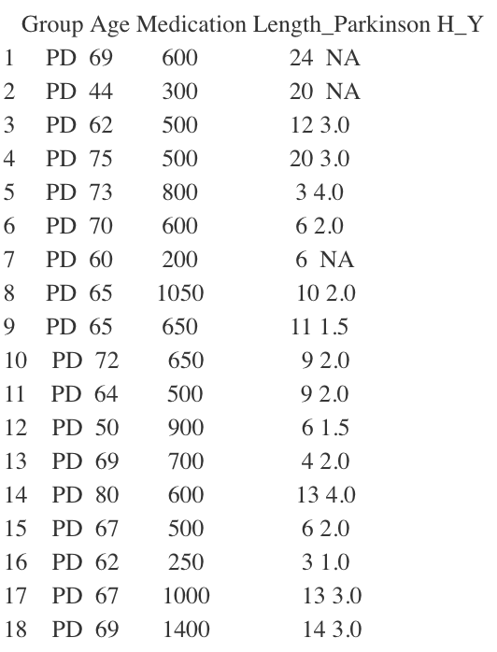
Table 1
Using the tidies dataset
Filter for group == PD
Selected 5 columns
Notes:
"Group","Age", "Medication", "Length_Parkinson","H_Y"

Slide 10
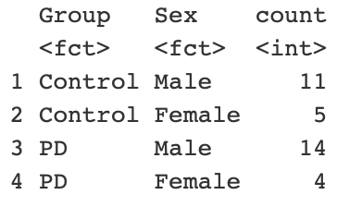
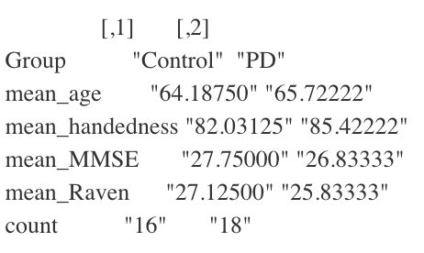
Table 3
Used the tidied dataset
Selected 6 columns
Grouped by “Group”
Used a separate table to show the amount of males and females in each group
Notes:
"Age", "Sex", "Handedness","MMSE","RAVEN","Group"

Slide 11
Table 9
Using tidied dataset
Selected seven columns using select
Used gather to collect columns into a dictionary with the Error_type as key and the according value is named total_number
Notes:
We selected seven columns: Group”,“Nrm_Reformulation”,“Nrm_FilledPause”,“Nrm_Repetition”,“Nois_Reformulation”,“Nois_FilledPause”, “Nois_Repetition”

Slide 12
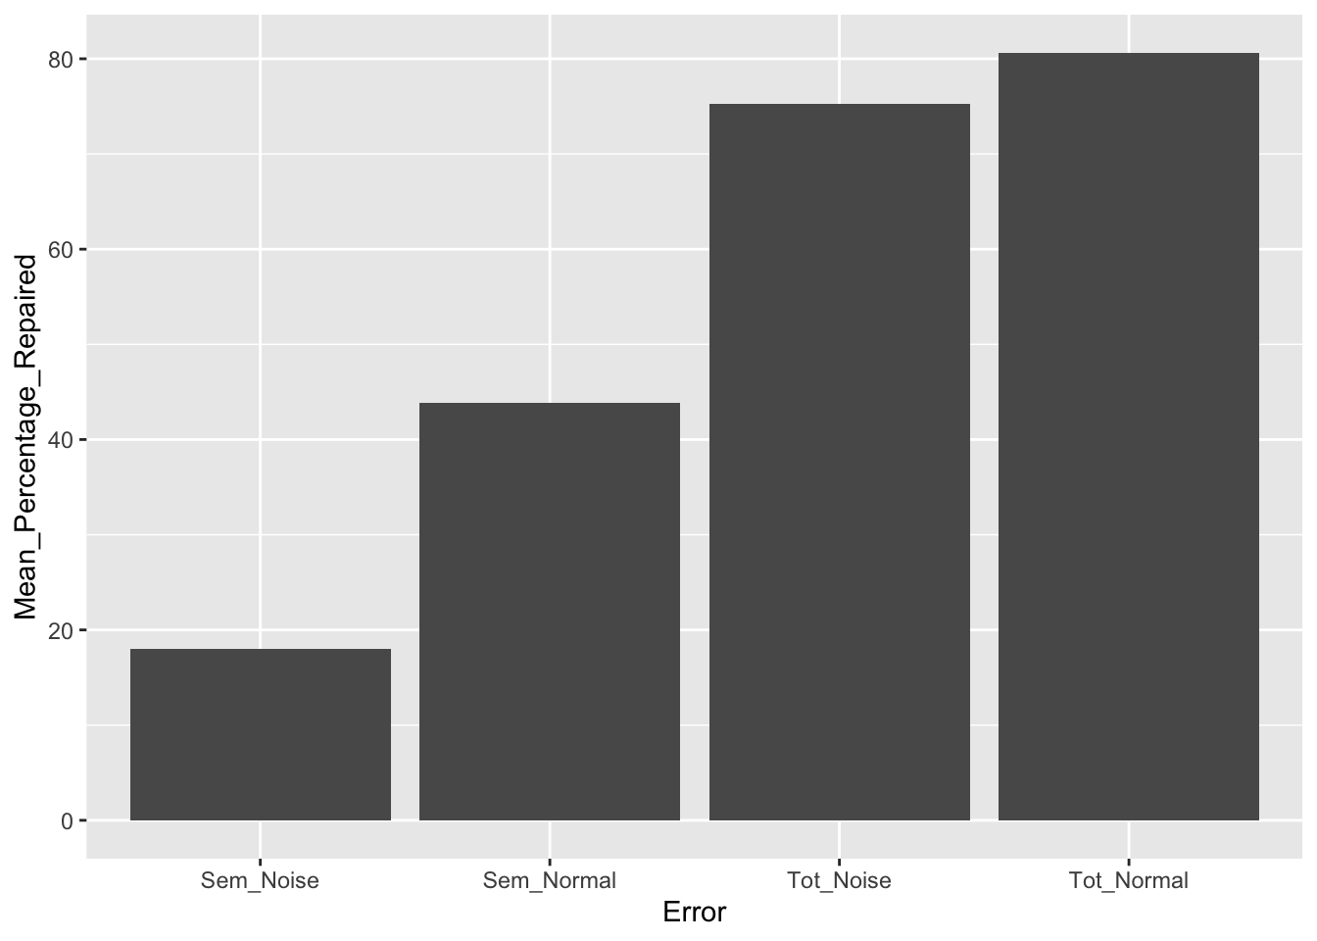
Figure 1

Slide 13
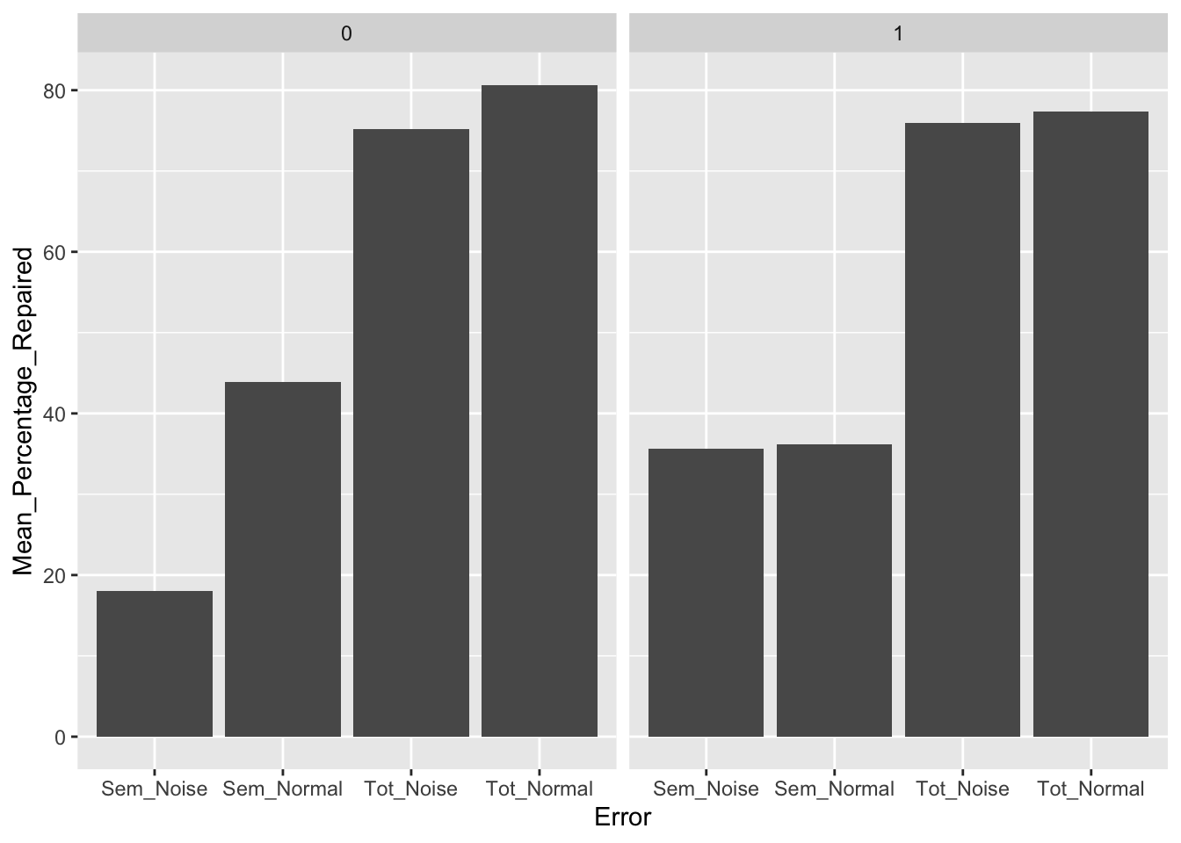
Figure 2

Slide 14
Three biggest takeaways from doing this project
Structured methods and tools exist for analyzing speech in neurodegenerative disease models
Identifying the meaning of variables in raw data and determining erroneous data is critical to successful reproduction of results
The combination of input data and method of analysis can result in drastically different conclusions
Notes:
Literature review and comparisons embedded throughout paper

Slide 15
Thanks & Questions

